Slide 1
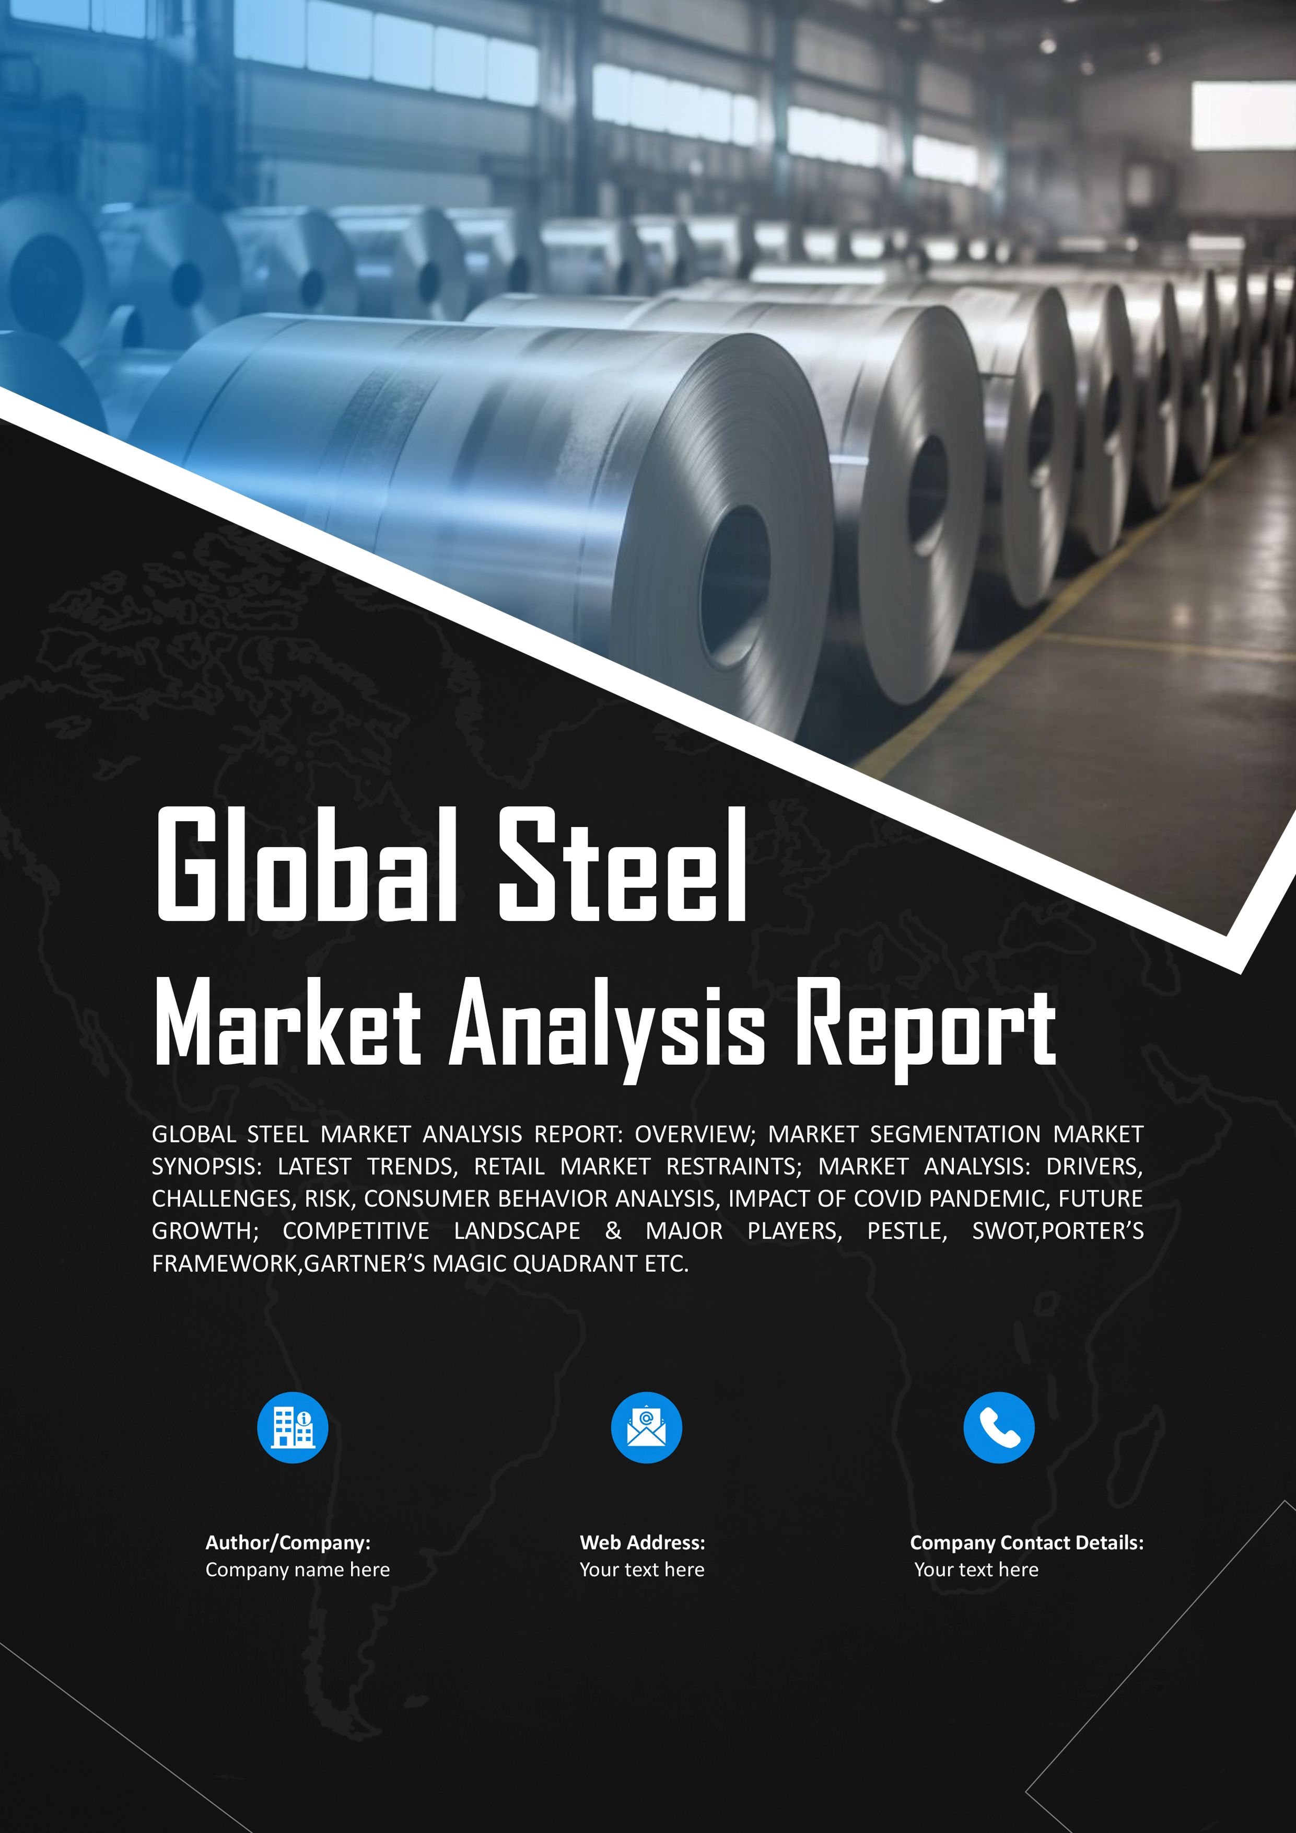


A Brief Presentation on
Steel Scenario & Potential in Odisha

Slide 2
Global Steel Sector Overview
Global Iron Ore Reserves 190,000 MMT
Global steel market size was USD 1,823.5 billion (US$1.82 Tn) in 2022
Others 17%
India Canada ^{3%}
3%
Ukraine 3%
Australia
30%
Anticipated to grow at 4.4% CAGR and reach USD 2,901.9 billion (US$ 2.9 Tn) by 2033
B&C predicts a long-term growth trend and forecasts global demand of around 2.06 billion tons for 2030. This corresponds to growth of 8.6% compared to 2022.
China 11%
Brazil
18%
Russia 15%
In 2025, Asia and Oceania will be the largest consumer of finished steel products, with approximately 1.25 billion metric tons of expected demand
Global Iron Ore Production 2,537 MMT
Others 21%
Australia
35%
Globally ~52% of steel is used in Building & Infrastructure sectors followed by Mechanical Equipment (16%), Automobile (12%), Metal Products (10%) etc
Ukraine 3%
Russia 4%
Global Iron Ore production is ~2.5 Billion Metric Tons and Australia produces ~35% of global production followed by Brazil, China and India
India 9%
Brazil
14%
China 14%

Slide 3
Indian Steel Sector Overview
India has 35286 MMT of Iron Ore reserves. (Odisha 26%)
2nd Largest Steel Producer in World (125.32 MT)
Indian steel companies contributing ~ 2% of India’s GDP
158 kg per Capita Steel Consumption by 2030-31 (Global Avg. 219 kg in 2023.
Domestic Steel Production (MT)
8% increase in demand in 2024 and 2025
In Developing World, 3.5% increase in demand in 2024, with a projected increase of 4.2% in 2025

Slide 4
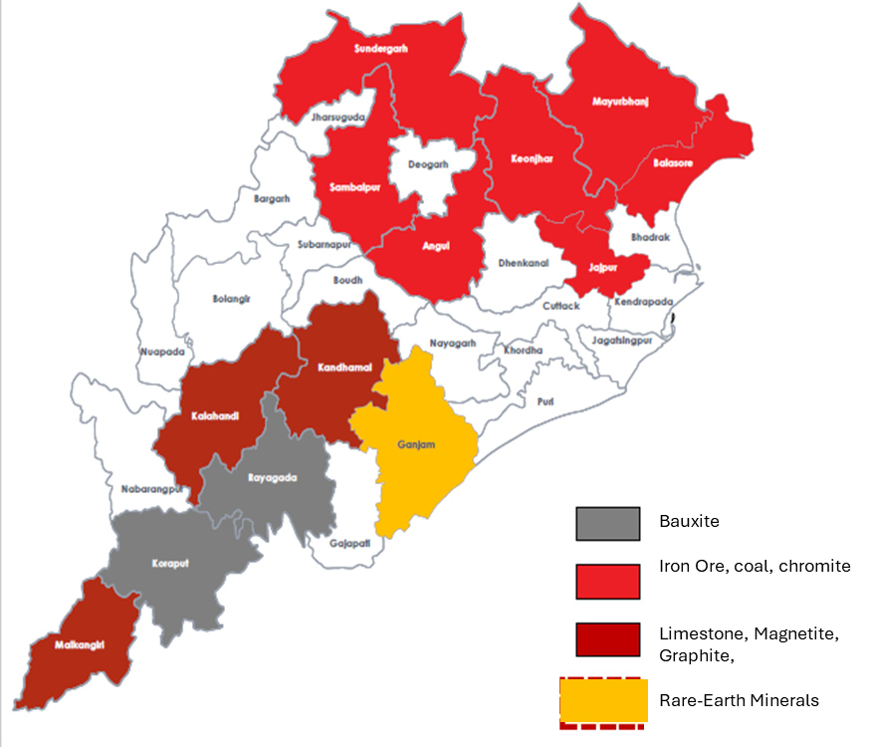
Odisha Steel Sector Overview
Abundant Mineral Resources of Odisha
Chromite (96%), Nickel (92%), Bauxite (53%), Mn.& Iron Ore (35%) of
India’s Mineral Reserves.
Odisha is Contributing to 41.9 % of all Minerals in India in value term. (Rs.38,075 Cr.).
Odisha is India's largest DRI Producer (15 MnTPa)
52 operational Steel Plants with capacity of 34 MnTPA & Targeted to achieve > 130 MTPA by 2030.
The state is strategically located as a gateway to ASEAN region having access to 50% of World Economy in a span of 6 hours.
For Ease of doing business, Odisha has numerous facilities:
Capital Investment Subsidy of 20% with no Upper Cap Limit
100% Reimbursement of Net SGST paid
Pioneer in Single Window Facilitation
Strategic Location (3 Ports & 5 Airports)
100% reimbursement of ESI / EPF upto 7 Years.

Slide 5
Odisha: Steel Industry
Productions Trends of Steel, Sponge Iron, Pallets
32
Million Tons
Major Steel Clusters of Odisha
Sr No | Cluster | No of Plants
1 | Angul | 2
2 | Cuttack | 5
3 | Dhenkanal | 6
4 | Jajpur | 1
5 | Ganjam | 1
6 | Jagatsinghpur | 1
7 | Jharsuguda | 7
8 | Keonjhar | 8
9 | Sambalpur | 5
10 | Sundargarh | 5
11 | Jajpur | 4
 | Total* | 45
27
25.77
22.34
22.87
23.72
22
19.89
19.65
20.5
19.27
17
16.54
16.49
12
9.74
6.82
7.67
7.87
7
5.8
2
2017-18
2018-19
Steel
2019-20
Sponge Iron
2020-21
Pellets
2021-22
Department of Steel and Mines, Government of Odisha
Odisha holds No.1 position in the production of Steel and Stainless Steel in India and has produced 25.12 million tons of Crude Steel in 2022-23
Odisha produced more than 60% of the Total Iron Ore produced in the country in 2022-23

Slide 6
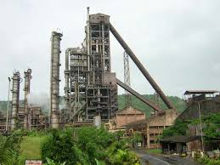
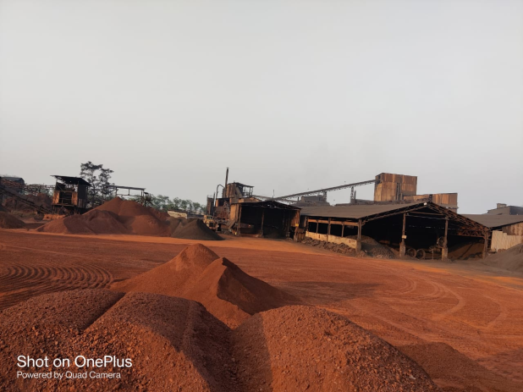
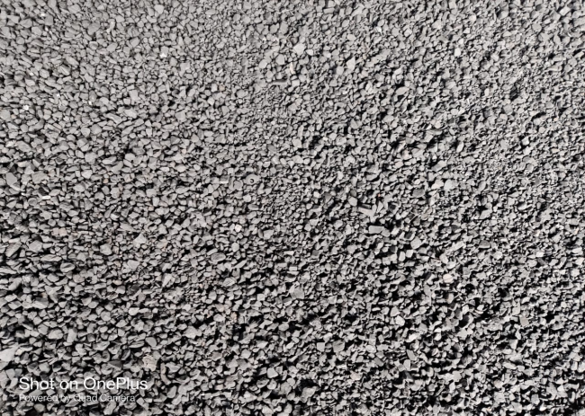
Vikram Steel
About Existing Plant
Product Type : Spong Iron
Existing Capacity of the Plant (DRI) : 60,000 TPA
ANNUAL TURNOVER & PAT [IN CR.]
Projected

Slide 7
Vikram Steel
PHASE-I EXPANSION PLAN
PROJECTED TURNOVER V EBITDA
Iron Ore Beneficiation Plant : 0.85 MTPA
Rs. In Cr.
Pelletizing Plant : 0.60 MTPA
 | FY 2026-27 | FY 2027-28 | FY 2028-29 | FY 2029-30 | FY 2030-31
TURNOVER | 552 | 1769 | 3024 | 3168 | 3776
EBITDA | 140 | 352 | 553 | 590 | 660
Steel Making Shop : 1,20,000 TPA
Rolling Mill : 1,00,000 TPA
Power Plant : 10 MWH
TOTAL PROJECT COST = 450 CR.
PHASE-II EXPANSION PLAN
Phase-I :
Iron Ore Beneficiation Plant Commercial production will commence from March 2026
Balance project will be completed within 24 months.
DRI Plant (4 x 350 TPD) : 4,62,500 TPA
Pelletizing Plant : 8,50,000 TPA
Steel Making Shop : 5,28,000 TPA
Rolling Mill : 5,12,160 TPA
Phase-II :
DRI Plant will be completed in two Phases (1st Phase-March 27 & 2nd Phase-March 28
Pellet Plant will be completed by March 2029
Power Plant, SMS & Rolling Mill will be completed in two phases (1st Phase by March 2028 & 2nd Phase by March 2030
Power Plant : 75 MWH
TOTAL PROJECT COST = 1560 CR.
Total Project Cost :
₹ 2010 Cr.

Slide 8



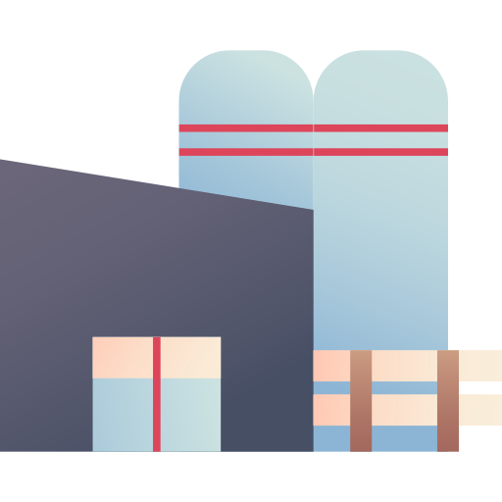

Thank You
Alupur, Near Laxminarayan Temple, O.T. Road, Balasore 756001
Plot No. 347-358, Gadabhanga, Khantapada, Balasore 756043
info@highlandgroups.com

